Slide 1
PeopleSoft Automation
Participants : Sameer Khanna, Kathy Kha, Sidhant Dayal, Vineet Wadwekar, Shivangi Tyagi, Venkat P, Karthik R, Sourav Mitra, Shyam Jha, Ramesh N, Bhanu M and Jatin P.

Slide 2
Automation Status as on 17th Feb 2021
Focus Area | Regression Test Cases |  | Progression Automation – Identified in Sprint 5 |  | Comment
 | Total | Verified / Working | Automatable | Automated
HCM | 311 | 311 | 7 | 4 | Existing 6 test cases will be used for progression testing in this sprint.
GL | 422 | 422 | 6 | 6
AM | 238 | 238
LA | 78 | 78
AP | 419 | 419
Purchasing | 95 | 95
E-Proc | 44 | 44 | 6 | 2 | Identified 3 Existing test cases which needs to be updated/used for progression testing ETA: 26th Feb 2021

Slide 3
Execution Status as on 17th Feb 2021
Focus Area |  | Regression Test Cases |  |  |  |  |  |  |  | Comment
 | Planned End Date | Automated | Manual | Total Regression test cases | Executed till 17th Feb | Pass | Fail | Not Executed | Defect Resolved | ETA
GL - Cycle 1 | 25 Dec 2020 | 422 | 34 | 456 | 451 | 451 | 0 | 5 | 42 out of 42 | Completed except for 5 Manual Test cases related archival are deferred to PT upgrade (ETA 20th Feb) and 1 failed test case.
GL – Cycle 2 | 11 Apr 2021 | 422 | 34 | 456 | 68 | 33 | 35 | 388 | 22 out of 27 | Script verification completed in dev. Execution commenced from 9th Feb
AM –Cycle 1 | 25 Dec 2020 | 238 | 18 | 256 | 256 | 256 | 0 | 0 | 3 out of 3 | Completed.
AM-Cycle 2 | 11 Apr 2021 | 238 | 18 | 256 | 35 | 16 | 19 | 221 | 6 out of 7 | Script verification completed in dev. Execution commenced from 9th Feb

Slide 4
Execution Status as on 17th Feb2021
Focus Area |  | Regression Test Cases |  |  |  |  |  |  |  | Comment
 | Planned End Date | Automated | Manual | Total Regression test cases | Executed till 17th Feb 2021 | Pass | Fail | Not Executed | Defect Resolved | ETA
LA –Cycle 1 | 25 Dec 2020 | 78 | 0 | 78 | 78 | 78 | 0 | 0 | 0 | Completed.
LA- Cycle 2 | 11 Apr 2021 | 78 | 0 | 78 | 9 | 0 | 9 | 69 | 2 out of 3 | Script verification completed in dev.
AP-Cycle1 |  | 419 | 26 | 445 | 445 | 445 | 0 | 0 | 1 out of 1 | Completed
AP-Cycle2 | 5 Mar 2021 | 423 | 26 | 449 | 205 | 191 | 14 | 218 | 0 | Cycle 2 repurposed for PT upgrade and execution shifted to GBFUSUP2. Identified 72 TCs which needs to be updated to handle login/logout credentials in a separate library.

Slide 5
Execution Status as on 17th Feb2021
Focus Area |  | Regression Test Cases |  |  |  |  |  |  |  | Comment
 | Planned End Date | Automated | Manual | Total Regression test cases | Executed till 16 Feb 2021 | Pass | Fail | Not Executed | Defect Resolved | ETA
Purchasing-Cycle1 |  | 95 | 0 | 95 | 95 | 95 | 0 | 0 | 0 | Completed
Purchsing-Cycle2 | 19 Feb 2021 | 95 | 0 | 95 | 95 | 89 | 6 | 0 | 0 | Cycle 2 repurposed for PT upgrade and execution shifted to GBFUSUP2.
E-Proc-Cycle1 |  | 44 | 0 | 44 | 44 | 44 | 0 | 0 | 0 | Completed
E-Proc-Cycle2 | 3 Mar 2021 | 44 | 0 | 44 | 44 | 44 | 0 | 0 | 0 | Planning to trigger another run post Requisition approval workflow scenarios gets automated in GBFUSUP2 region.

Slide 6
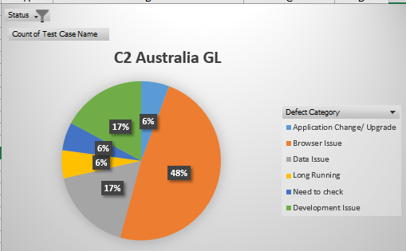
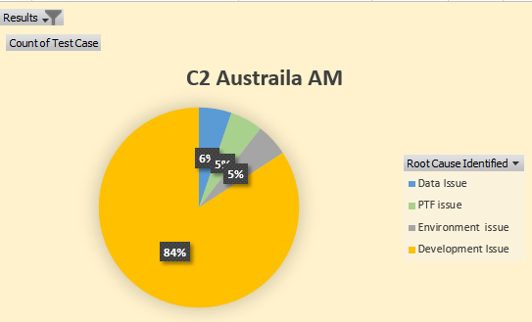
Defect Distribution

Slide 7
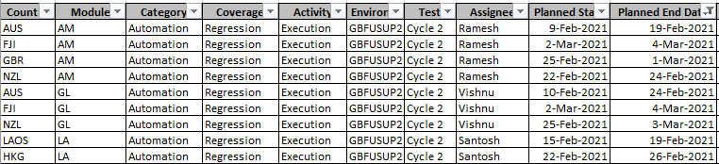
Projection for next 2 weeks

Slide 8
Blocker & Environment issue
Sl No | Backlog / Issue | Raised On | Owner | Status | Aging | Comment
1 | INC3268563 – Long running Online Journal Edit in China | 14th Dec 21 | Kiran | Open | 49
2 | INC3434981 – Jobs failing with Out of memory issue | 9th Feb 21 | Venkat | Open | 7 | Temp solution – shut ETE environment on server. Permanent Solution to be implemented.
3 | INC3438545 - Wrapper Jobs are going to queued in CNFUSYS1 region | 10th Feb 21 | Venkat | Closed | 5 | INC3438545 - Wrapper Jobs are going to queued in CNFUSYS1 region
4 | INC3438537 - Cross Reciprocal Process is running to Errors | 10th Feb 21 | Venkat | Closed | 2 | INC3438537 - Cross Reciprocal Process is running to Errors
5 | Oracle SR -SR 3-24746654751 : Test parameters are not getting fetched into the PTF editor when we try to open a test case | 15th Dec 20 | Ramesh Nellimarla | Closed | 41 | Issue is not seen in PT858, can be closed.
6 | Defect Id – COFES-602 Page Getting Expired while trying to Create Journals - CNFUSYS1 | 30th Nov 20 | Sourav M | Closed | 15
7 | RITM1720028 - Process failed with error "unable to extend segment by 128 in undo tablespace 'UNDOTBS1'" in SYS1(GBPOC858) | 18th Jan 21 | DB Team | Closed | 2

Slide 9
Blocker & Environment issue
Sl No | Backlog / Issue | Raised On | Owner | Status | Aging | Comment
8 | INC3406832 – Reporting jobs are running to Errors in GBFUSUP2 region | 01st Feb 21 | Arvindan Jambu | Closed
9 | INC3414988 – Missing nVisions in GBPOC858 | 02nd Feb 21 | Arvindan Jambu | Closed
10 | INC3415013 - JEDIT and FS_JGEN process running long in GBPOC858 | 02nd Feb 21 | Madhav Mannem | Closed
11 | RITM1706427 – Request for connection settings for PT8.58 PTF | 12th Jan 21 | Arvindan Jambu | Closed
12 | RITM1724350 - Not able to run PTF tests in 8.58 in RD: APPAU301MEL0772.globaltest.anz.com | 19th Jan 21 | Arvindan Jambu | Closed
13 | RITM1706657 - FM Extract failed in GBFAUQA1 | 12th Jan 21 | Arvindan Jambu | Closed
14 | INC3342386 – Error while logging in to PTF (GBFAUQA1) | 11th Jan 21 | Arvindan Jambu | Closed
15 | INC3345167 – Error while logging in to PTF (GBFAUQA1) | 12th Jan 21 | Arvindan Jambu | Closed
16 | COFES- 461 / Oracle SR -3-24599858141 : SSL Error while trying to get the test script | 28th Oct | Madhav M | Closed

Slide 10
Regression Execution Status - Cycle - 2

Slide 11
On – Going Tracking
Initiative Name | Current Status | Confluence link
Implementation of good practices. Draft V1. | Document available in confluence page | https://confluence.service.anz/display/CEE/ANZ+PEOPLESOFT+TEST+FRAME+WORK
Module for maintaining login credentials | Working as expected | https://confluence.service.anz/display/CEE/ANZ+PEOPLESOFT+TEST+FRAME+WORK

Slide 12
Automation Status as on 3rd Feb 2021
Focus Area | Regression Test Cases |  | Progression Automation – Identified in Sprint 4 |  | Comment
 | Total | Verified / Working | Automatable | Automated
HCM | 311 | 311 | 6 | 5 | Existing 8 test cases will be used for progression testing in this sprint.
GL | 422 | 422 | 4 | 4
AM | 238 | 238
LA | 78 | 78
AP | 419 | 419 | 4 | 4 | Existing 4 test cases were used/updated for progression testing
Purchasing | 95 | 95
E-Proc | 44 | 44

Slide 13
Execution Status as on 3rd Feb 2021
Focus Area | Regression Test Cases |  |  |  |  |  |  |  | Comment
 | Automated | Manual | Total Regression test cases | Executed till 2nd Feb | Pass | Fail | Not Executed | Defect Resolved | ETA
GL - Cycle 1 | 422 | 34 | 456 | 451 | 451 | 0 | 5 | 42 out of 42 | Completed except for 5 Manual Test cases related archival are deferred to PT upgrade (ETA 20th Feb) and 1 failed test case.
GL – Cycle 2 | 422 | 34 | 456 | 84 | 79 | 5 | 372 | 7 out of 8 | Script verification in progress in PT upgrade dev environment. Cycle 2 execution to follow as soon as GBFUSP2 is ready.
AM –Cycle 1 | 238 | 18 | 256 | 256 | 256 | 0 | 0 | 3 out of 3 | Completed.
AM-Cycle 2 | 238 | 18 | 256 | 140 | 120 | 20 | 116 | 1 out of 1 | Script verification in progress in PT upgrade dev environment

Slide 14
Execution Status as on 3rd Feb2021
Focus Area | Regression Test Cases |  |  |  |  |  |  |  | Comment
 | Automated | Manual | Total Regression test cases | Executed till 02 Feb 2021 | Pass | Fail | Not Executed | Defect Resolved | ETA
LA –Cycle 1 | 78 | 0 | 78 | 78 | 78 | 0 | 0 | 0 | Completed.
LA- Cycle 2 | 78 | 0 | 78 | 0 | 0 | 0 | 78 | 0 | Cycle 2 re-purposed to include PT upgrade and test execution is re-initiated in GBPOC858
AP-Cycle1 | 419 | 26 | 445 | 445 | 445 | 0 | 0 | 1 out of 1 | Completed
AP-Cycle2 | 423 | 26 | 449 | 46 | 46 | 0 | 403 | 0 | Cycle 2 re-purposed to include PT upgrade and test execution. Received New VMs which are built on Windows server 2016 OS.

Slide 15
Execution Status as on 3rd Feb2021
Focus Area | Regression Test Cases |  |  |  |  |  |  |  | Comment
 | Automated | Manual | Total Regression test cases | Executed till 02 Feb 2021 | Pass | Fail | Not Executed | Defect Resolved | ETA
Purchasing-Cycle1 | 95 | 0 | 95 | 95 | 95 | 0 | 0 | 0 | Completed
Purchsing-Cycle2 | 95 | 0 | 95 | 63 | 61 | 2 | 32 | 0 | Cycle 2 re-purposed to include PT upgrade and test execution. Received New VMs which are built on Windows server 2016 OS. ETA : 08 Feb 2021
E-Proc-Cycle1 | 44 | 0 | 44 | 44 | 44 | 0 | 0 | 0 | Completed
E-Proc-Cycle2 | 44 | 0 | 44 | 44 | 44 | 0 | 0 | 0 | Cycle 2 re-purposed to include PT upgrade and test execution. Received New VMs which are built on Windows server 2016 OS.

